Slide 1
The Simplex Method
The geometric method of solving linear programming problems presented before. The graphical method is useful only for problems involving two decision variables and relatively few problem constraints.
What happens when we need more decision variables and more problem constraints?
We use an algebraic method called the simplex method, which was developed by George B. DANTZIG (1914-2005) in 1947 while on assignment with the U.S. Department of the air force.

Slide 2



Standard Maximization Problems in Standard Form
A linear programming problem is said to be a standard maximization problem in standard form if its mathematical model is of the following form:
Maximize the objective function
Subject to problem constraints of the form
With non-negative constraints

Slide 3
Slack Variables
“A mathematical representation of surplus resources.” In real life problems, it’s unlikely that all resources will be used completely, so there usually are unused resources.
Slack variables represent the unused resources between the left-hand side and right-hand side of each inequality.

Slide 4
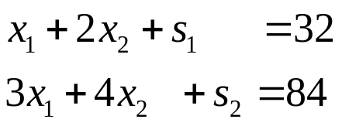
Basic and Nonbasic Variables
Basic variables are selected arbitrarily with the restriction that there be as many basic variables as there are equations. The remaining variables are non-basic variables.
This system has two equations, we can select any two of the four variables as basic variables. The remaining two variables are then non-basic variables. A solution found by setting the two non-basic variables equal to 0 and solving for the two basic variables is a basic solution. If a basic solution has no negative values, it is a basic feasible solution.

Slide 5
SIMPLEX METHOD
Step-1
Write the standard maximization problem in standard form, introduce slack variables to form the initial system, and write the initial tableau.
Step-3
Select the pivot column
Step-5
Select the pivot element and perform the pivot operation
Step 2
Are there any negative indicators in the bottom row?
Step 4
Are there any positive elements in the pivot column above the dashed line?
STOP
The optimal solution has been found.
STOP
The linear programming problem has no optimal solution
Simplex algorithm for standard maximization problems

Slide 6
To solve a linear programming problem in standard form, use the following steps.
1- Convert each inequality in the set of constraints to an equation by adding slack variables.
2- Create the initial simplex tableau.
3- Select the pivot column. ( The column with the “most negative value” element in the last row.)
4- Select the pivot row. (The row with the smallest non-negative result when the last element in the row is divided by the corresponding in the pivot column.)
5-Use elementary row operations calculate new values for the pivot row so that the pivot is 1 (Divide every number in the row by the pivot number.)
6- Use elementary row operations to make all numbers in the pivot column equal to 0 except for the pivot number. If all entries in the bottom row are zero or positive, this the final tableau. If not, go back to step 3.
7- If you obtain a final tableau, then the linear programming problem has a maximum solution, which is given by the entry in the lower-right corner of the tableau.

Slide 7
Pivot
Pivot Column: The column of the tableau representing the variable to be entered into the solution mix (a nonbasic variable -> basic).
Pivot Row: The row of the tableau representing the variable to be replaced in the solution mix (a basic variable -> nonbasic).
Pivot Number: The element in both the pivot column and the pivot row.

Slide 8
Simplex Tableau
Most real-world problems are too complex to solve graphically. They have too many corners to evaluate, and the algebraic solutions are lengthy. A simplex tableau is a way to systematically evaluate variable mixes in order to find the best one.

Slide 9
Initial Simplex Tableau
 | All variables | Solution
Basic variables | coefficients
 |  | 0

Slide 10
EXAMPLE
The Cannon Hill furniture Company produces tables and chairs. Each table takes four hours of labor from the carpentry department and two hours of labor from the finishing department. Each chair requires three hours of carpentry and one hour of finishing. During the current week, 240 hours of carpentry time are available and 100 hours of finishing time. Each table produced gives a profit of $70 and each chair a profit of $50. How many chairs and tables should be made?

Slide 11






STEP 1
All information about example
Resource | Table s ( ) | Chairs ( ) | Constraints
Carpentry (hr) | 4 | 3 | 240
Finishing (hr) | 2 | 1 | 100
Unit Profit | $70 | $50
Objective Function
Carpentry Constraint
Finishing Constraint
Non-negativity conditions

Slide 12


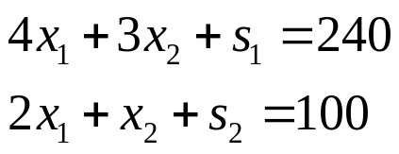
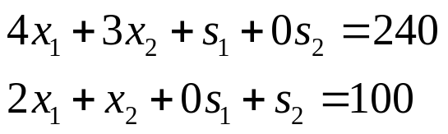
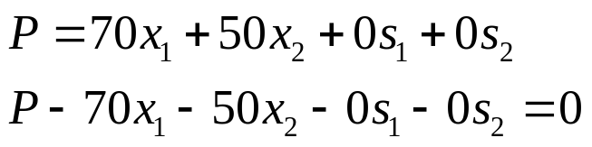
The first step of the simplex method requires that each inequality be converted into an equation. ”less than or equal to” inequalities are converted to equations by including slack variables.
Suppose carpentry hours and finishing hours remain unused in a week. The constraints become;
or
As unused hours result in no profit, the slack variables can be included in the objective function with zero coefficients:

Slide 13

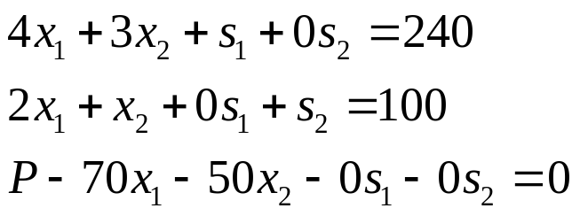
The problem can now be considered as solving a system of 3 linear equations involving the 5 variables in such a way that P has the maximum value;
Now, the system of linear equations can be written in matrix form or as a 3x6 augmented matrix. The initial tableau is;

Slide 14
STEP 2
Basic Variables | x₁ | x₂ | S₁ | S₂ | P | Right Hand Side
S₁ | 4 | 3 | 1 | 0 | 0 | 240
S₂ | 2 | 1 | 0 | 1 | 0 | 100
P | -70 | -50 | 0 | 0 | 1 | 0
The tableau represents the initial solution;
The slack variables S₁ and S₂ form the initial solution mix. The initial solution assumes that all avaliable hours are unused. i.e. The slack variables take the largest possible values.

Slide 15
Variables in the solution mix are called basic variables. Each basic variables has a column consisting of all 0’s except for a single 1. all variables not in the solution mix take the value 0.
The simplex process, a basic variable in the solution mix is replaced by another variable previously not in the solution mix. The value of the replaced variable is set to 0.

Slide 16
STEP 3
Select the pivot column (determine which variable to enter into the solution mix). Choose the column with the “most negative” element in the objective function row.
Basic Variables | x₁ | x₂ | S₁ | S₂ | P | Right hand side
S₁ | 4 | 3 | 1 | 0 | 0 | 240
S₂ | 2 | 1 | 0 | 1 | 0 | 100
P | -70 | -50 | 0 | 0 | 1 | 0
Pivot column
x₁ should enter into the solution mix because each unit of x₁ (a table) contributes a profit of $70 compared with only $50 for each unit of x₂ (a chair)

Slide 17
Step 4
Are there any positive elements in the pivot column above the bottom row?
Yes, so we can go on step 5

Slide 18


STEP 5
Select the pivot row (determine which variable to replace in the solution mix). Divide the last element in each row by the corresponding element in the pivot column. The pivot row is the row with the smallest non-negative result.
Enter
Basic Variables | x₁ | x₂ | S₁ | S₂ | P | Right hand side
S₁ | 4 | 3 | 1 | 0 | 0 | 240
S₂ | 2 | 1 | 0 | 1 | 0 | 100
P | -70 | -50 | 0 | 0 | 1 | 0
Exit
Pivot row
Pivot column
Pivot number

Slide 19

Should be replaced by x₁ in the solution mix. 60 tables can be made with 240 unused carpentry hours but only 50 tables can be made with 100 finishing hours. Therefore we decide to make 50 tables.
Now calculate new values for the pivot row. Divide every number in the row by the pivot number.
Basic Variables | x₁ | x₂ | S₁ | S₂ | P | Right hand side
S₁ | 4 | 3 | 1 | 0 | 0 | 240
x₁ | 1 | 1/2 | 0 | 1/2 | 0 | 50
P | -70 | -50 | 0 | 0 | 1 | 0

Slide 20


Use row operations to make all numbers in the pivot column equal to 0 except for the pivot number which remains as 1.
Basic Variables | x₁ | x₂ | S₁ | S₂ | P | Right hand side
S₁ | 0 | 1 | 1 | -2 | 0 | 40
x₁ | 1 | 1/2 | 0 | 1/2 | 0 | 50
P | 0 | -15 | 0 | 35 | 1 | 3500
If 50 tables are made, then the unused carpentry hours are reduced by 200 hours (4 h/table multiplied by 50 tables); the value changes from 240 hours to 40 hours. Making 50 tables results in the profit being increased by $3500; the value changes from $0 to $3500.

Slide 21


In this case,
Now repeat the steps until there are no negative numbers in the last row.
Select the new pivot column. x₂ should enter into the solution mix.
Select the new pivot row. S₁ should be replaced by x₂ in the solution mix.
Enter
Basic Variables | x₁ | x₂ | S₁ | S₂ | P | Right hand side
S₁ | 0 | 1 | 1 | -2 | 0 | 40
x₁ | 1 | 1/2 | 0 | 1/2 | 0 | 50
P | 0 | -15 | 0 | 35 | 1 | 3500
Exit
New pivot row
New pivot column

Slide 22
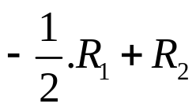

Calculate new values for the pivot row. As the pivot number is already 1, there is no need to calculate new values for the pivot row.
Use row operations to make all numbers in the pivot column equal to except for the pivot number.
Basic Variables | x₁ | x₂ | S₁ | S₂ | P | Right hand side
x₂ | 0 | 1 | 1 | -2 | 0 | 40
x₁ | 1 | 0 | -1/2 | 3/2 | 0 | 30
P | 0 | 0 | 15 | 5 | 1 | 4100

Slide 23
If 40 chairs are made, then the number of tables are reduced by 20 tables (1/2 table/chair multiplied by 40 chairs); the value changes from 50 tables to 30 tables. The replacement of 20 tables by 40 chairs results in the profit being increased by $600; the value changes from $3500 to $4100.
As the last row contains no negative numbers, this solution gives the maximum value of P.

Slide 24

Result
This simplex tableau represents the optimal solution to the LP problem and is interpreted as:
and profit or P=$4100
The optimal solution (maximum profit to be made) is to company 30 tables and 40 chairs for a profit of $4100.

Slide 25
Example-2
A farmer owns a 100 acre farm and plans to plant at most three crops. The seed for crops A,B, and C costs $40, $20, and $30 per acre, respectively. A maximum of $3200 can be spent on seed. Crops A,B, and C require 1,2, and 1 workdays per acre, respectively, and there are maximum of 160 workdays available. If the farmer can make a profit of $100 per acre on crop A, $300 per acre on crop B, and $200 per acre on crop C, how many acres of each crop should be planted to maximize profit?

Slide 26
The Dual Problem: Minimization with problem constraints of the form ≥
Linear programming problems exist in pairs. That is in linear programming problem, every maximization problem is associated with a minimization problem. Conversely, associated with every minimization problem is a maximization problem. Once we have a problem with its objective function as maximization, we can write by using duality relationship of linear programming problems, its minimization version. The original linear programming problem is known as primal problem, and the derived problem is known as dual problem.

Slide 27
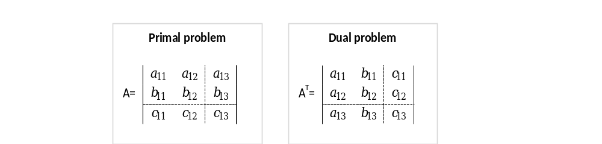
Thus, the dual problem uses exactly the same parameters as the primal problem, but in different locations. To highlight the comparison, now look at these same two problems in matrix notation.
Primal Problem |  |  | Dual Problem
Minimize | Z=cx |  | Maximize | W=yb
Subject to | Ax≥b |  | Subject to | yA≤c
and | x≥0 |  | And | y≥0

Slide 28
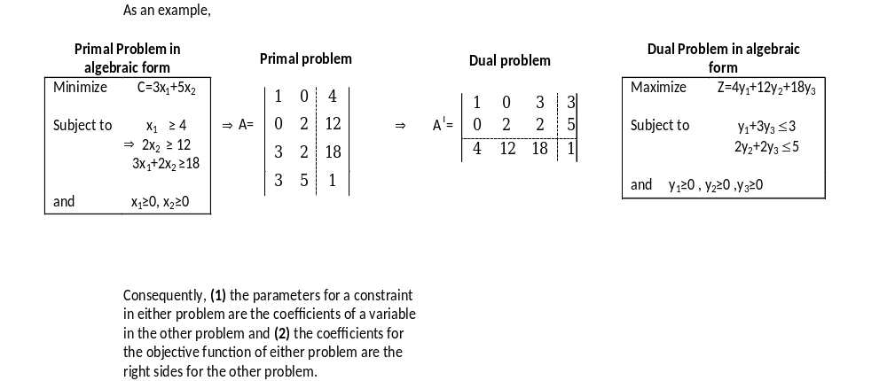

Slide 29
Summary
Primal | Dual
(a) Maximize. | Minimize
(b) Objective Function. | Right hand side.
(c) Right hand side. | Objective function.
(d) i th row of input-output coefficients. | i th column of input output coefficients.
(e) j th column of input-output coefficients. | j the row of input-output coefficients.

Slide 30
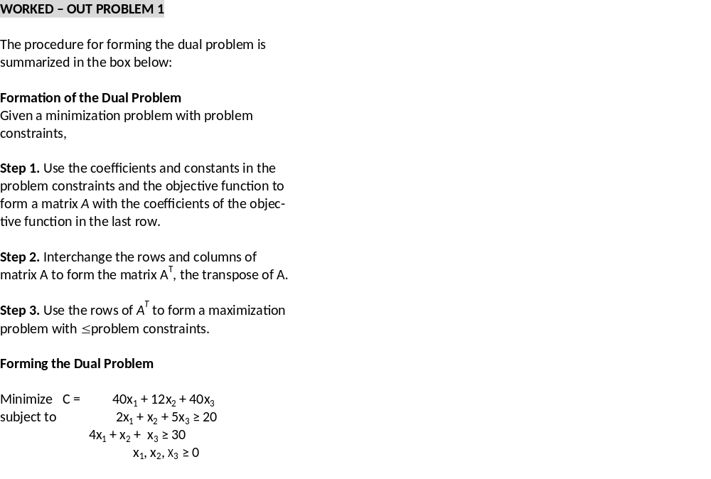

Slide 31
WORKED –OUT PROBLEM 2
Form the dual problem:
Minimize C = 16 x₁ + 9x₂ + 21x₃
subject to x₁ + x₂ + 3x₃ ≥ 12
2x₁ + x₂ +x₃ ≥ 16
x₁, x₂, x₃ ≥ 0

Slide 32
Solution of Minimization Problems
ORIGINAL PROBLEM (1) Minimize C = 16x₁ + 45x₂ | DUAL PROBLEM (2) Maximize P = 50y₁ + 27y₂
subject to 2x₁ + 5x₂ ≥ 50 x₁ + 3x₂ ≥ 27 x₁, x₂ ≥ 0 | subject to 2y₁ + y₂ ≤ 16 5y₁ + 3y₂ ≤ 45 y₁,y₂ ≥ 0

Slide 33
MINIMIZATION PROBLEMS
The Dual Form
Graphical Approach
Solution of Minimization Problems with Simplex Method
A Transportation Problem
The Big M method
Minimization by The Big M Method

